Slide 1
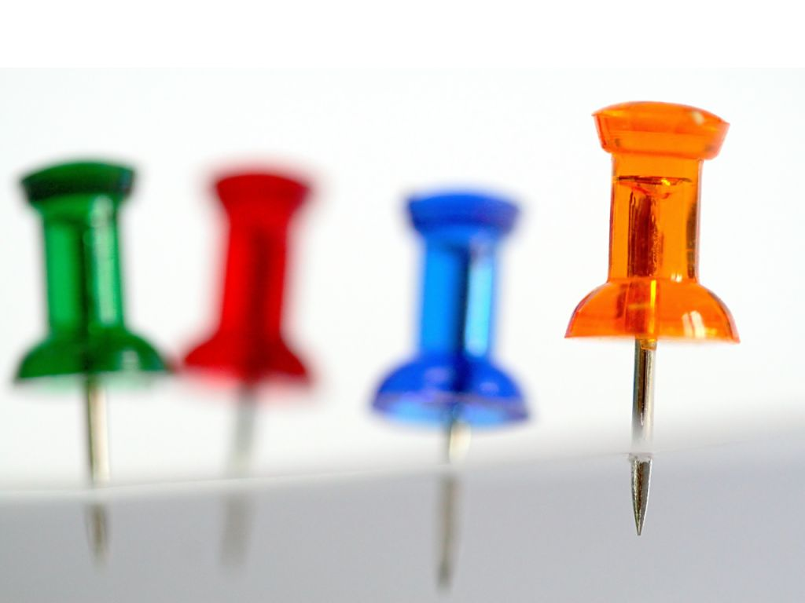
Introduction to F#
Functional Programming with .Net
Tormod Fjeldskår - @tormodfj
Photo: Erica Marshall

Slide 2
Agenda
Named Values
Functions
Recursion
Lists and Sequences
Modules
Interop with C#
Bonus Fun!

Slide 3
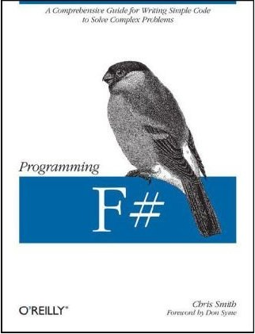
Recommended Reading
Programming F# by Chris Smith

Slide 4
Questions?

